Slide 1
Who are we talking about? when did the thing came into being? which market did it targeted? what was their vision?
So we are going to throw some light on the company SNAPDEAL.
Snapdeal is an Indian e-commerce company based in New Delhi, India.
The company was started by Kunal Bahland Rohit Bansalin February 2010.
In 2014 Snapdeal had 300,000 sellers, over 30 million products across 800+ diverse categories from over 125,000 regional, national, and international brands and retailers and a reach of 6,000 towns and cities across the country.

Slide 2
To cover following
Idea and how business started
Revenue model
Funding
Target groups
Cost benefit analysis
Project break down
Recovery
Current stage

Slide 3
Idea - Intialisation
Snapdeal set a niche for itself in the sphere of e-commerce in India.
In 2010, Kunal Bahl and Rohit Bansal wanted to start their own business, they chose an offline couponing business and named it MoneySaver.
15000 coupons were sold in three months and it was time to take the business to the next level.
It was after they met investor Vani Kola that the venture really took off.
The first meeting did not go well but after another round of discussion, Vani Kola’s venture capital firm decided to invest in Snapdeal.

Slide 4
Idea continue
Initially started as an offline business, Snapdeal went online in 2010.
It was a bumpy ride in the first few months.
Mistakes were made, but lessons were learnt.
It is this kind of hard work and diligent attempt to offer the best to the customers that gave Snapdeal its initial success.

Slide 5
Idea continue
However, the biggest decision of the founders came in November 2011.
Inspired by the success of Alibaba, Rohit and Kunal wanted to create something on similar lines.
The deals business was shut down and an online marketplace was opened instead.
It was a make or break decision.
Snapdeal had a huge market share in the deals business at that time and starting something new was very risky and the move surprised the investors too.
At that point of time, competitors were very less, though.

Slide 6
Snapdeal’s Business Model is mix of the following revenue lines:
Grabbon: Group buying site, now redirects to Snapdeal
Esportsbuy: Sports accessories retailing E-Commerce websites, acquired, shut it and added all the categories to its catalogue.
Shopo: It says no sale fee no listening fee. God knows what use is this to Snapdeal apart from one more channel for selling goods.
Doozton: No business, but the tech for displaying the fashion merchandise used to display products on snapdeal.com
Smartprix: Affiliate Website Model and Traffic Transfer via reviews, Comparison etc.

Slide 7
Fundings got till now in different rounds
ROUND 1: In January 2011, Snapdeal received a funding of $12 million from Nexus Venture Partners and Indo-US Venture Partners.
ROUND 2: In July 2011, the company raised a further $45 million from Bessemer Venture Partners, along with existing investors Nexus Venture Partners and Indo-US Venture Partners.
ROUND 3: Snapdeal then raised a 3rd round of funding worth $50 million from eBay and received participation from existing investors – i.e. Bessemer Venture Partners, Nexus Venture and IndoUS Venture Partners.

Slide 8
Fundings got till now in different rounds
ROUND 4: Snapdeal received its 4th round of funding of $133 million on Feb-2014. The 4th round of funding was led by eBay with all the current institutional investors, including Kalaari Capital, Nexus Venture Partners, Bessemer Venture Partners, Intel Capital and Saama Capital all participating.
ROUND 5: Snapdeal received its 5th round of funding of $105 million in May-2014. The 5th round included investments by Blackrock, Temasek Holdings, PremjiInvest and others. The round valued Snapdeal at $1,000,000,000.
ROUND 6: Snapdeal received its 6th round of funding in Oct-2014 from Softbank with investments worth $647 million in fresh capital.This makes SoftBank the largest investor in Snapdeal.

Slide 9
Company building and Target Groups
Snapdeal believes that basically, there are five key stakeholders in this kind of business.
Customers
Customer support
Technology platform
Merchants
Logistics

Slide 10
Company building and Target Groups
The goal is to figure out how to strengthen the linking among these five as each one interacts with multiple of the others.
Every line of code in Snapdeal is written in- house as they don’t outsource anything and don’t use other platforms.
They believe that if you want to build a fast-moving and agile platform, you need to build it yourself.
Their goal is simple- to keep providing the three things, which are important to the customer- Value, Assortment and Convenience.

Slide 11
Cost Benefit Analysis
Snapdeal gets the best offer possible from the merchants from around 65 cities across India and then deducts a small amount of commission.
Snapdeal aims at showing at least 40-60% off in the deals from what actually one has to pay. Depending upon how good the offer is, Snapdeal deducts their commission starting from Rs. 99 going up to Rs. 299.
For products, Snapdeal has a particular set of commission. The most ideal amount of commission Snapdeal charges with selling a product is 23%.

Slide 12
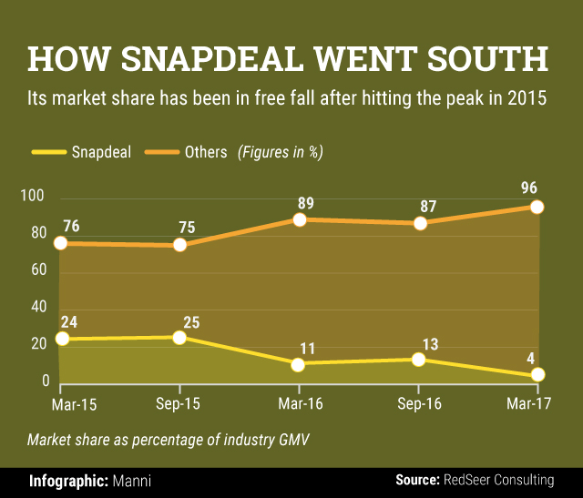
Eic project on fall of snapdeal

Slide 13
WHERE SNAPDEAL WENT WRONG
Counterparts focussed on growing markets of mobile , fashion electronics
Whereas snapdeal couldn’t land any major partnership in mobiles while flipkart and amazon were agressively working on winning mobile category by sponsored launches

Slide 14
FAILED ON HIGH MARGIN ,GROWING SEGMENTS
Snapdeal also couldn’t leverage on the high margin fast-growing fashion segment as it couldn’t offer the level of product assortment and quality offered by market leaders Flipkart (along with Myntra and Jabong) and Amazon.

Slide 15
OWN WAREHOUSES INSTEAD OF JOINTHOUSES
Snapdeal then moved to a managed or controlled marketplace model with own warehouses called SD+ centres to ensure some level of quality control.
However, it never adopted a hybrid model that has been followed by Flipkart and Amazon with WS Retail or Cloudtail, respectively, which helped them gain control on quality, cost and consumer experience.

Slide 16
QUALITY OF PRODUCTS, BROUGHT TRUST DOWN
The marketplace model did not allow Snapdeal to have any sort of control over quality of products. This has brought down the trust of customers on the company.

